Slide 1
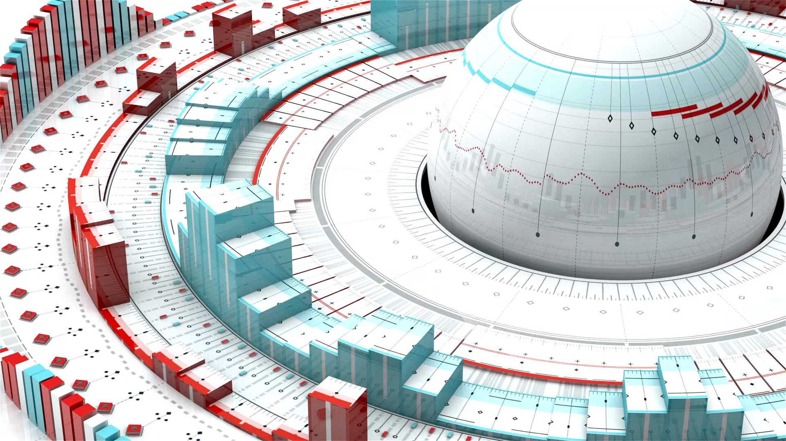
AWS Three tier Architecture Project
By Nagalakshmi Rajamoorthy
Student ID: 3097

Slide 2
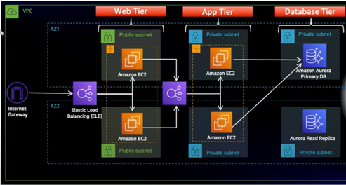
Project Overview
Architecture
We have three tiers such as Web Tier, App Tier and Database Tier.
We have a VPC with 2 Availability zones in a region. It has one Internet Gateway attached to six subnets. We have 2 public subnets and 4 private subnets. Public subnets have access to internet while private subnets doesn’t have.
The request from Internet Gateway is passed to External Loadbalancer which redirects to the backend EC2 servers in the Web Tier. These EC2 servers are part of Autoscaling group. The request from webservers are directed to the Internal Load balancer which is then redirected to the Appservers in the App Tier. All the requests from Appservers are directed to RDS. We have primary and secondary database. If Primary database fails, it will be replaced with Read replica(Secondary database). We have used high availability and fault tolerance in all the levels of the architecture.
Services used: VPC, EC2, RDS, S3, ELB, ASG and IAM.

Slide 3

Part 0 : Setup
Download code from Github
Create bucket in S3
Create IAM EC2 instance role
Command to download code
git clone https://github.com/aws-samples/aws-three-tier-web-architecture-workshop.git

Slide 4
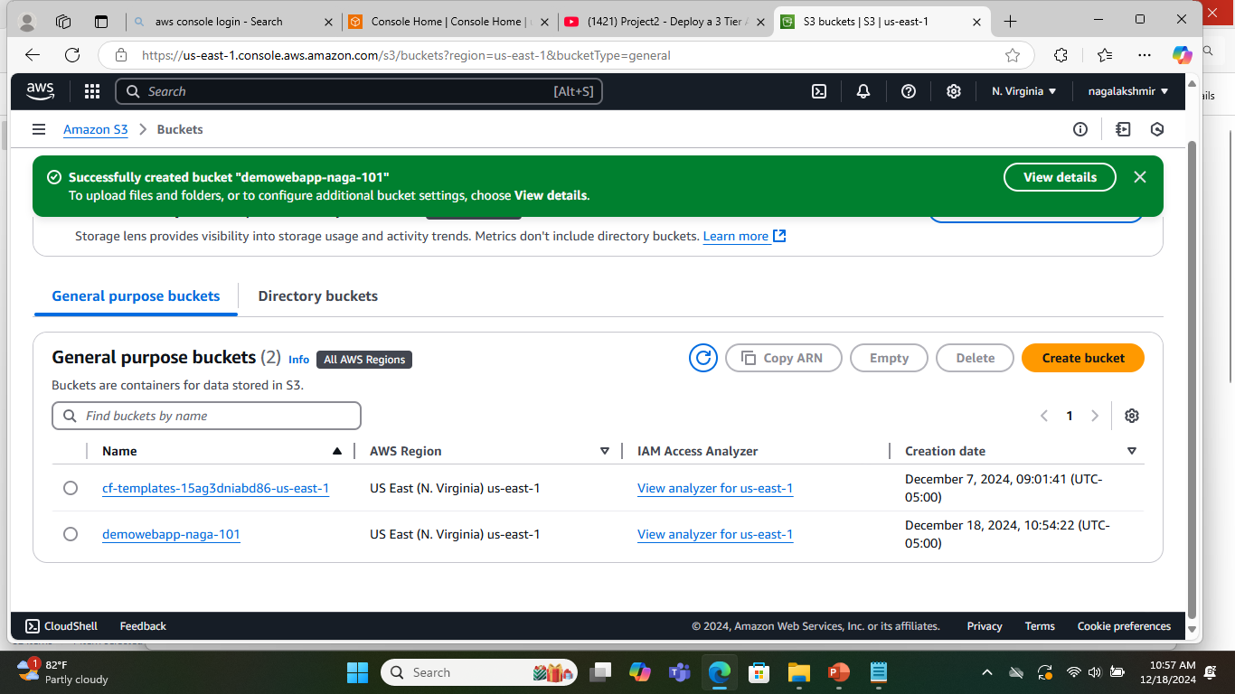
S3 bucket

Slide 5
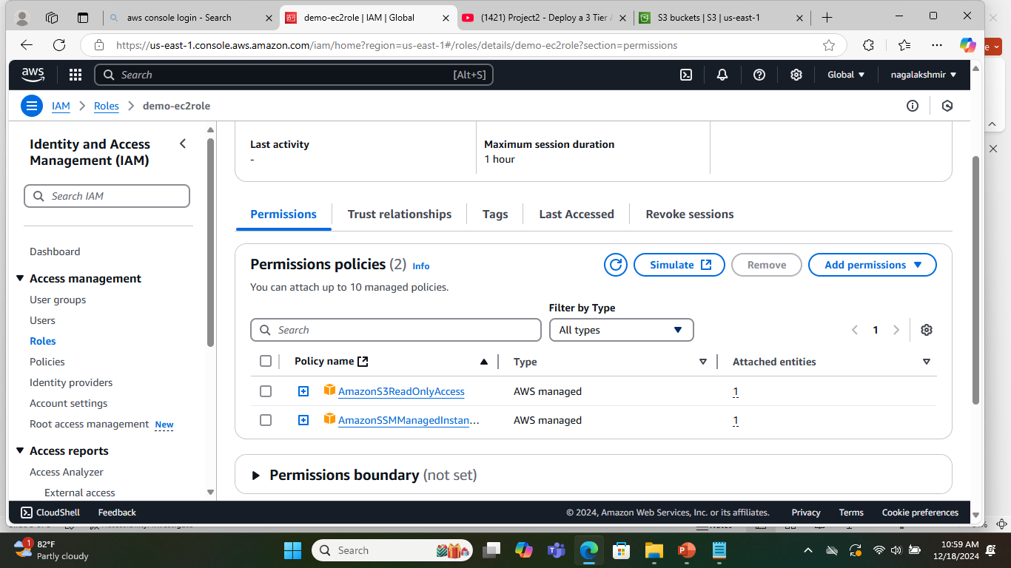
IAM EC2 instance role permissions: AWSS3ReadOnlyAccess, AmazonSSMManagedInstanceCore

Slide 6
Part 1 : Networking and Security
VPC and Subnets
Internet Connectivity
Routing Configuration
Security Groups
In this section we will be building out the VPC networking components as well as security groups that will add a layer of protection around our EC2 instances, Aurora Databases and Elastic load balancers.

Slide 7
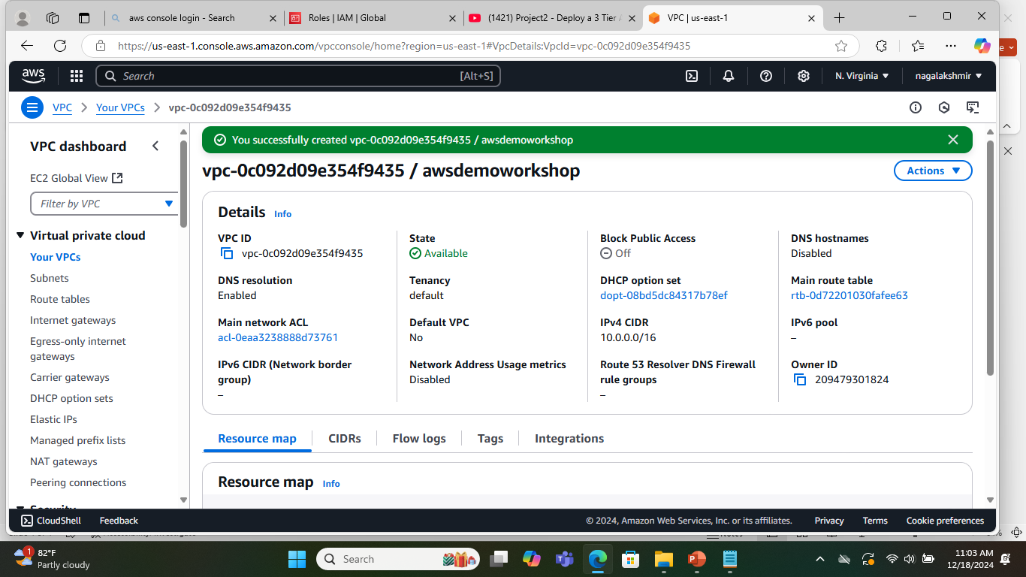
Virtual Private Cloud IPV4 CIDR : 10.0.0.0/16, Region : us-east-1

Slide 8
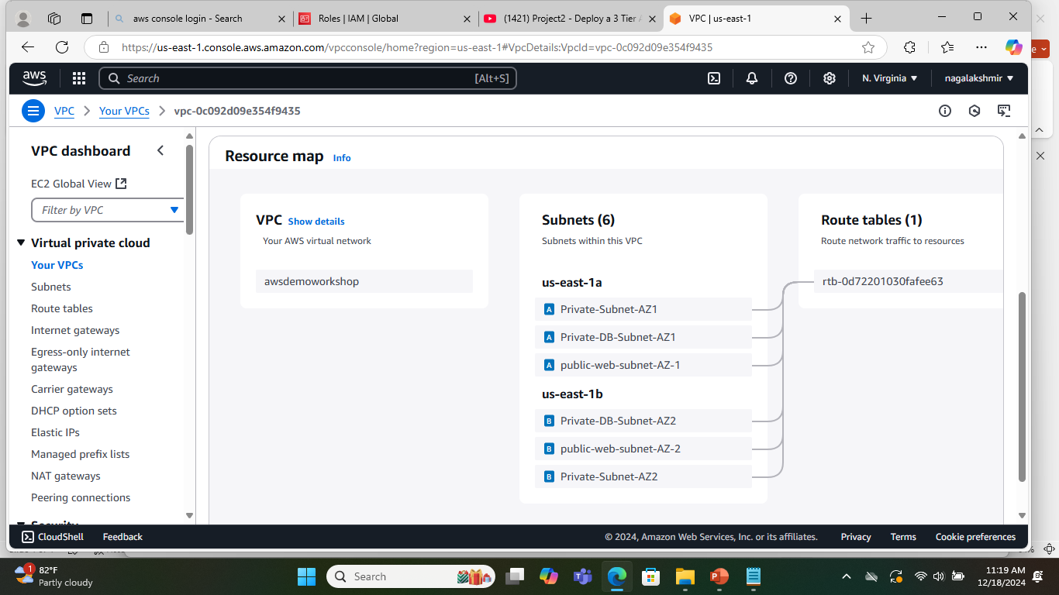
Six Subnets in the VPC spread across 2 Availability Zones(us-east-1a, us-east-1b)
public-web-subnet-AZ-1 : 10.0.0.0/24
public-web-subnet-AZ-2 : 10.0.1.0/24
Private-Subnet-AZ1 : 10.0.2.0/24
Private-Subnet-AZ2 : 10.0.3.0/24
Private-DB-Subnet-AZ1 : 10.0.4.0/24
Private-DB-Subnet-AZ2 : 10.0.5.0/24

Slide 9
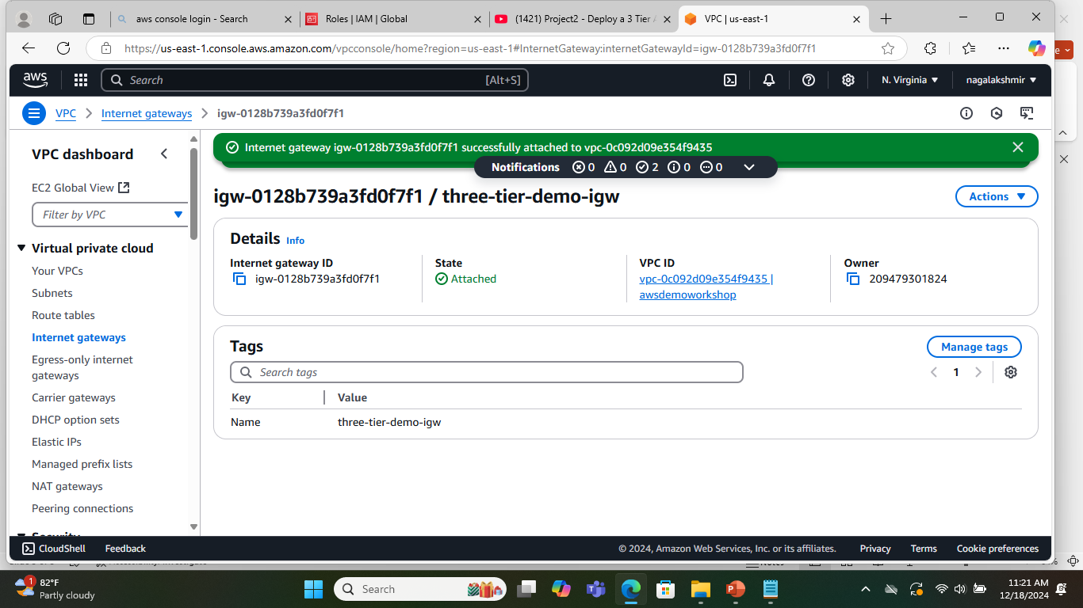
Internet Gateway attached to VPC

Slide 10
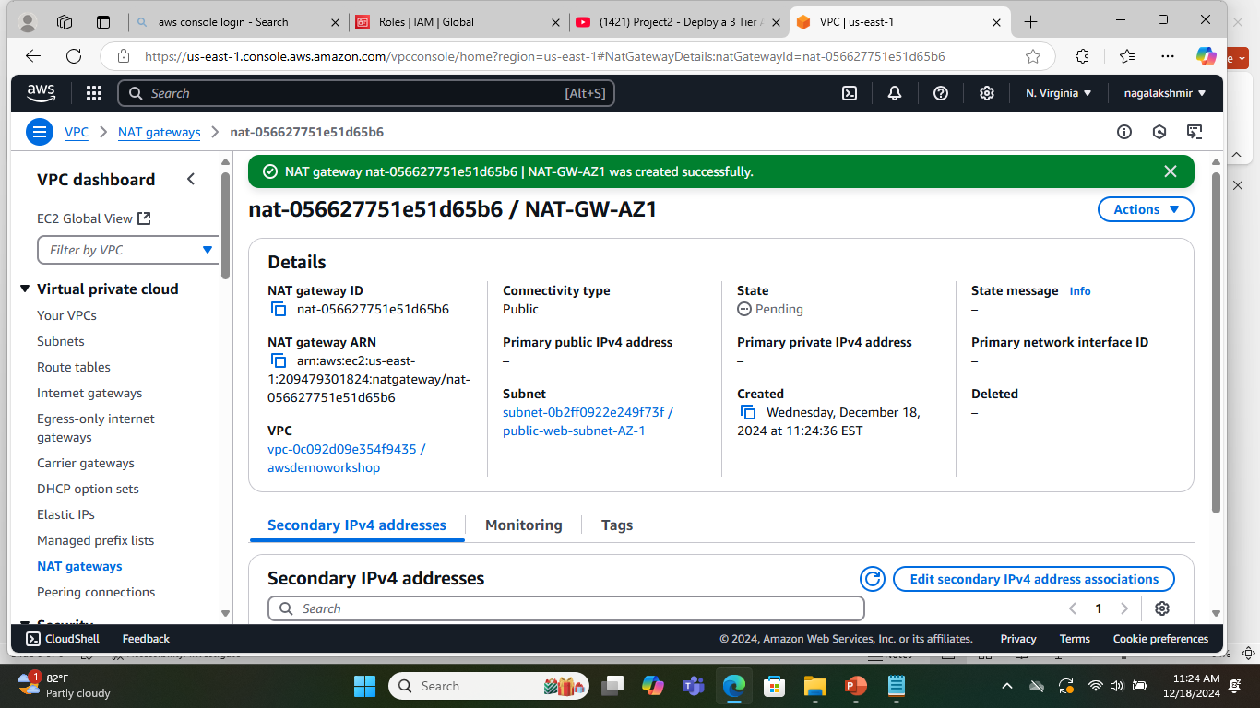

NAT Gateway – us-east-1a
NAT Gateway provides internet access to the instances in the private subnet

Slide 11
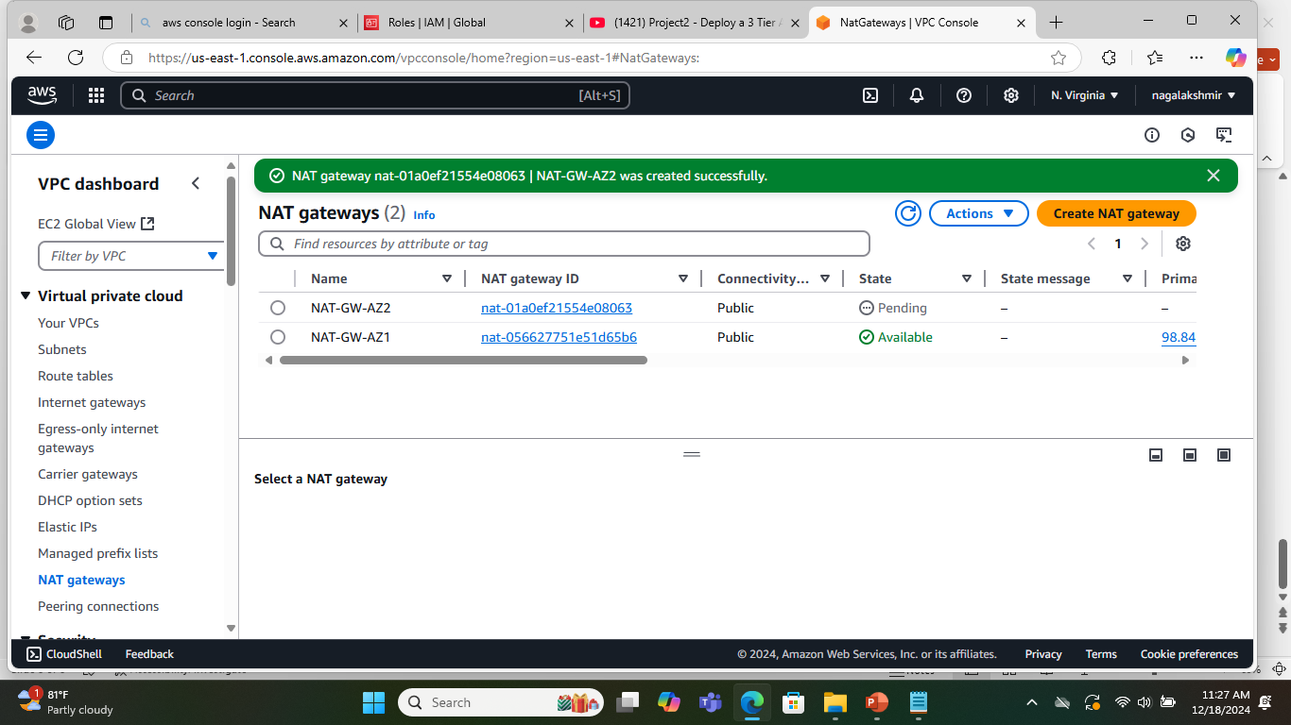
NAT Gateways for us-east-1a and us-east-1b

Slide 12
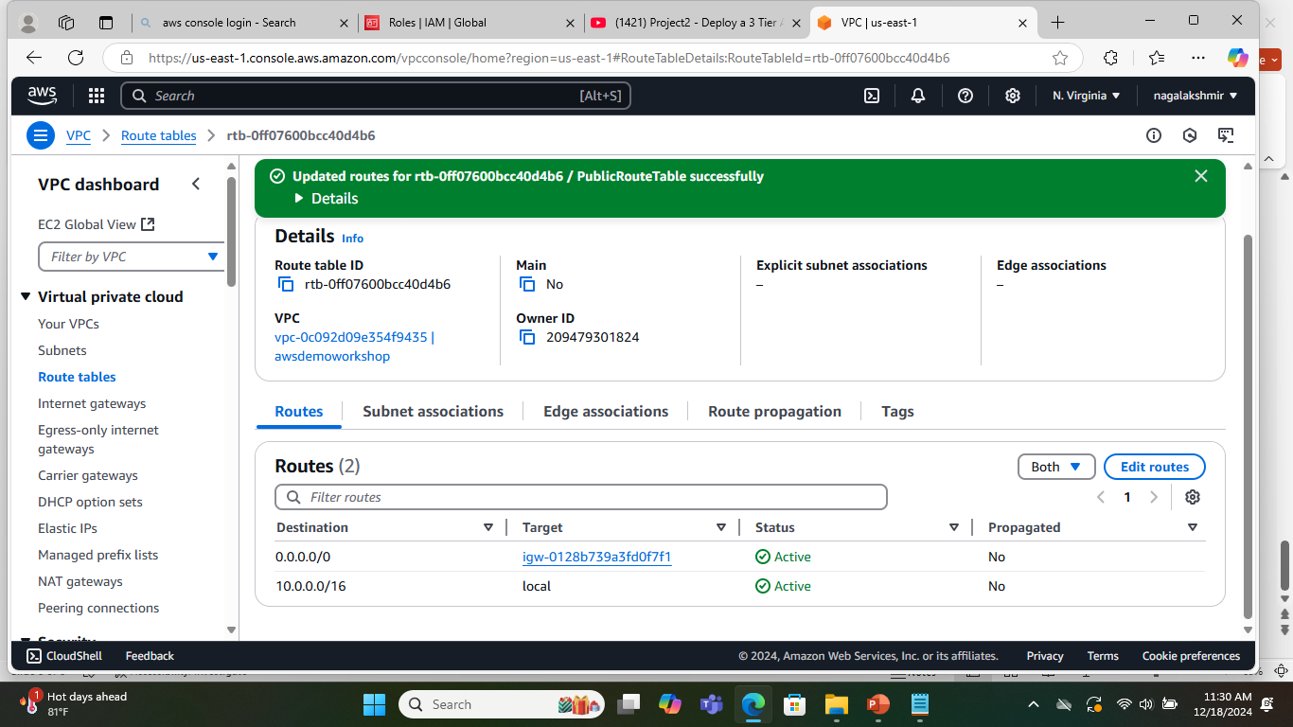
Routing Configuration
Route to Inetrnet Gateway provides internet access to the instances in the public subnets
Public Route table connects the instances to VPC and internet.

Slide 13
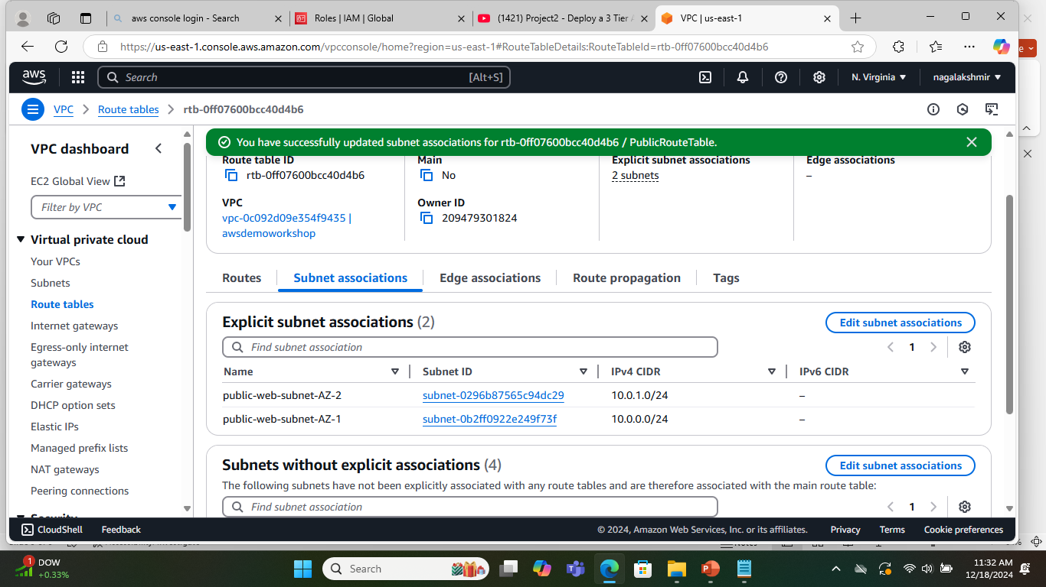
Subnet associations
Public Route table is associated with public subnets in us-east-1a and us-east-1b

Slide 14

Private Route table AZ1
Route to NAT Gateway in us-east-1a

Slide 15
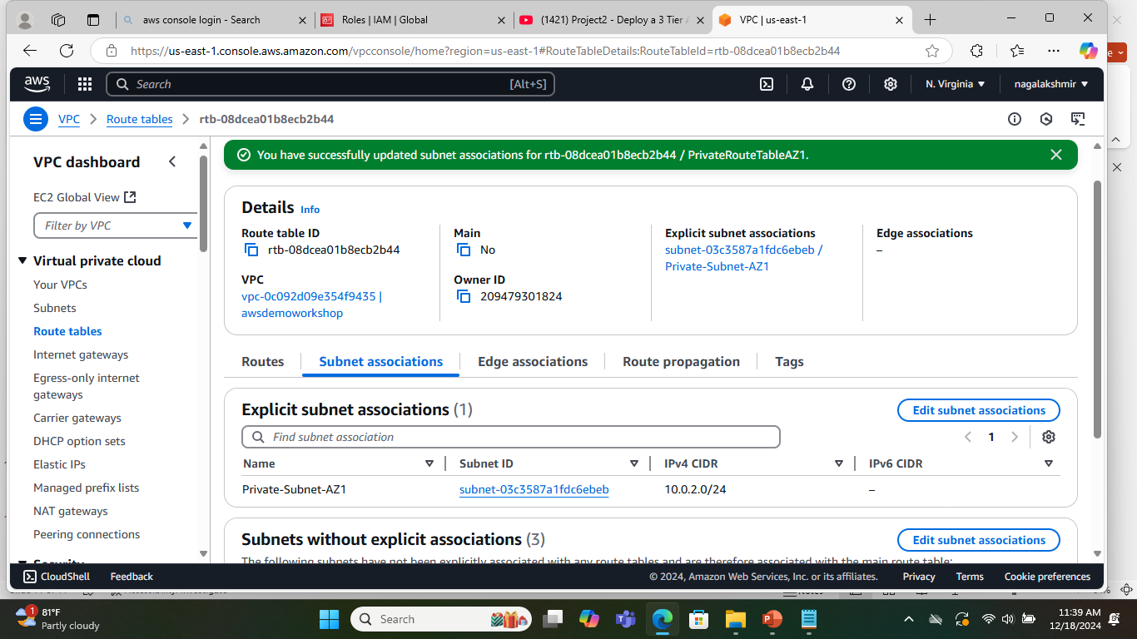
Private Route table AZ1
Private Route table AZ1 is associated with private subnet in us-east-1a

Slide 16
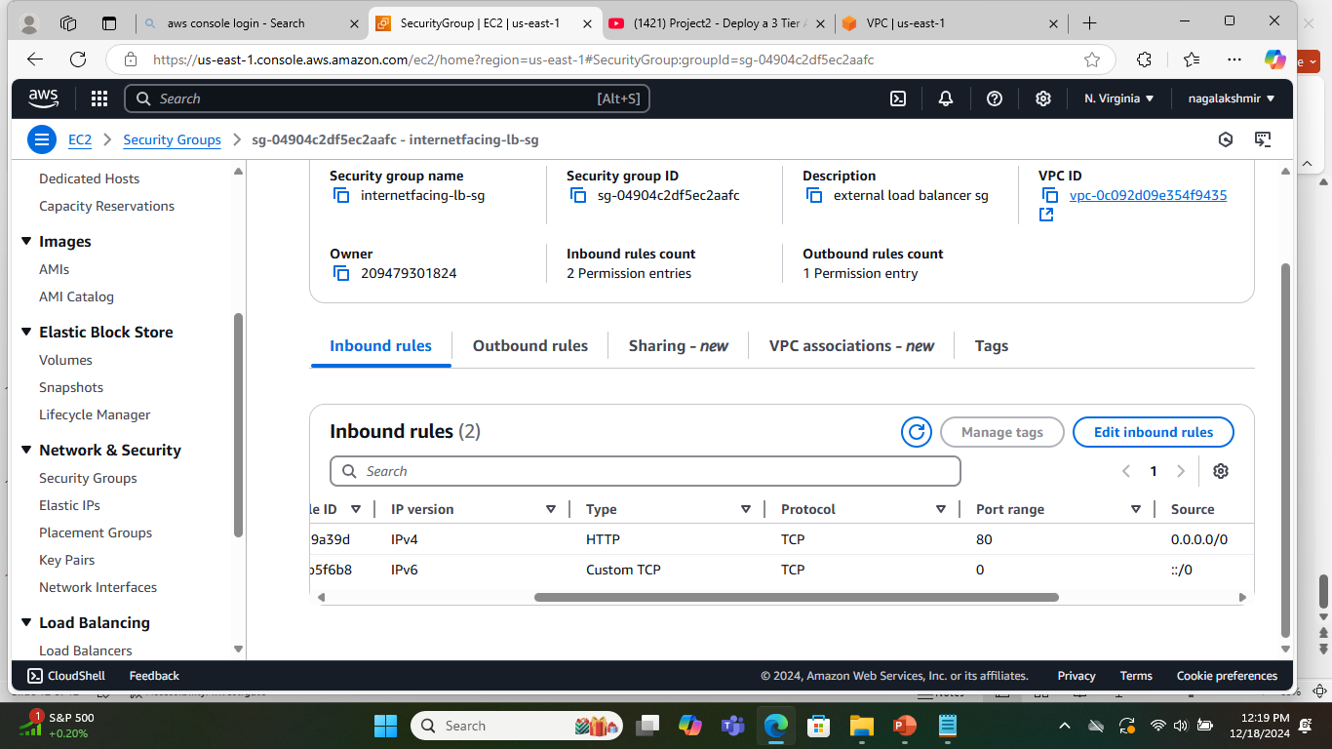
Security Groups
Security Groups open up certain ports to access the traffic in and out of the instances.
Internetfacing-lb-sg allows public internet access to the external load balancer.
It allows Http access on port 80 to the outside world.
It allows IPV6 as well.

Slide 17
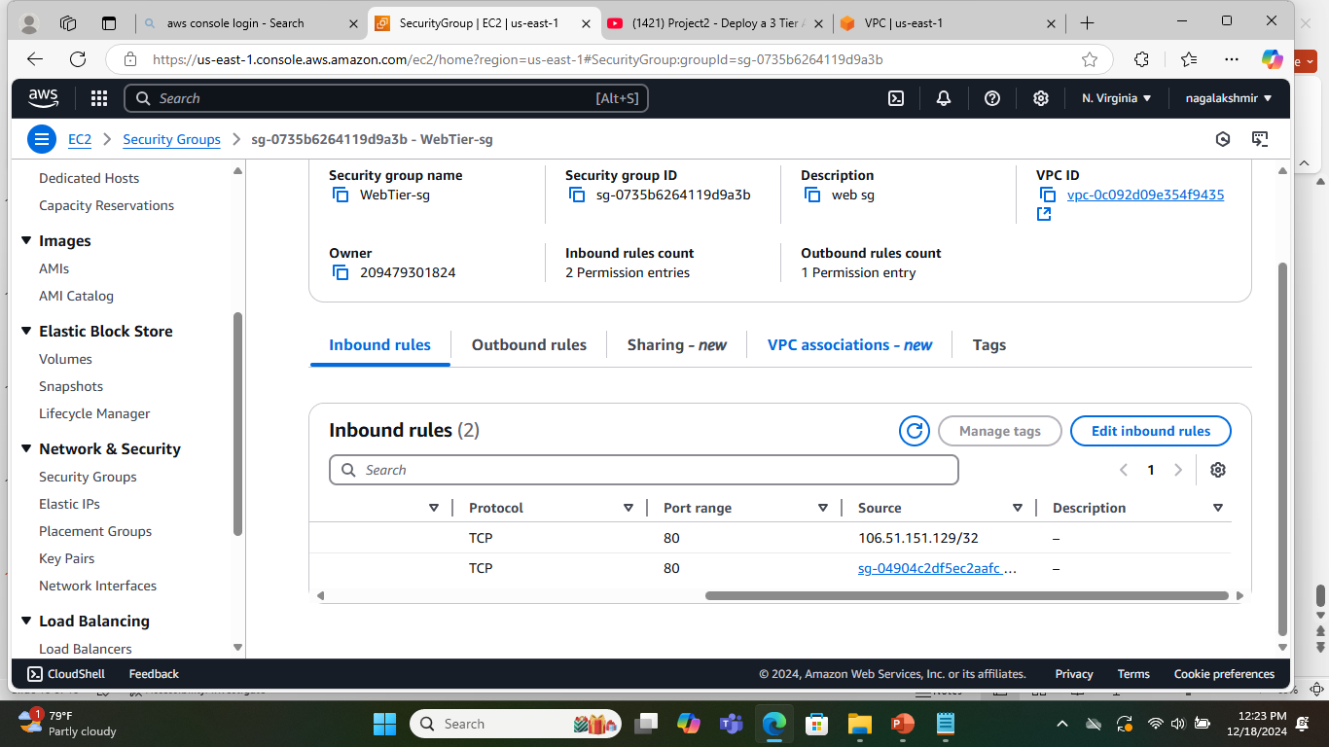
Web Tier Security Group
This Security Group provides access to the external load balancer and my IP Address on port 80.

Slide 18
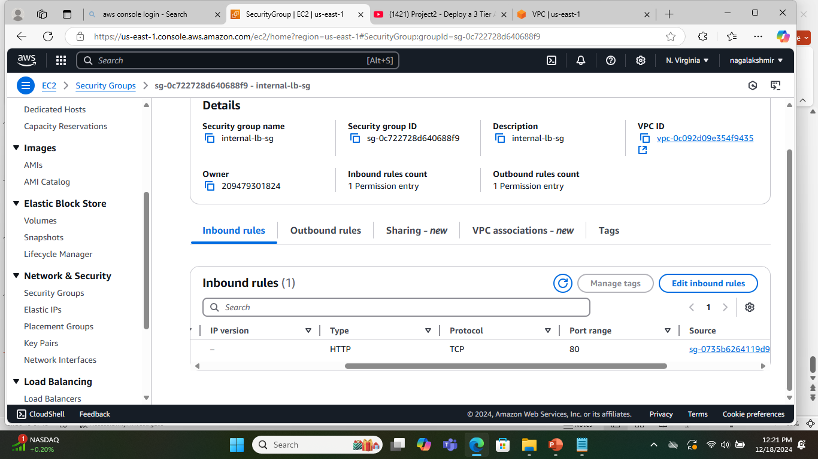
Internal Loadbalancer Security Group
This Security Group provides access to webserver on port 80.

Slide 19
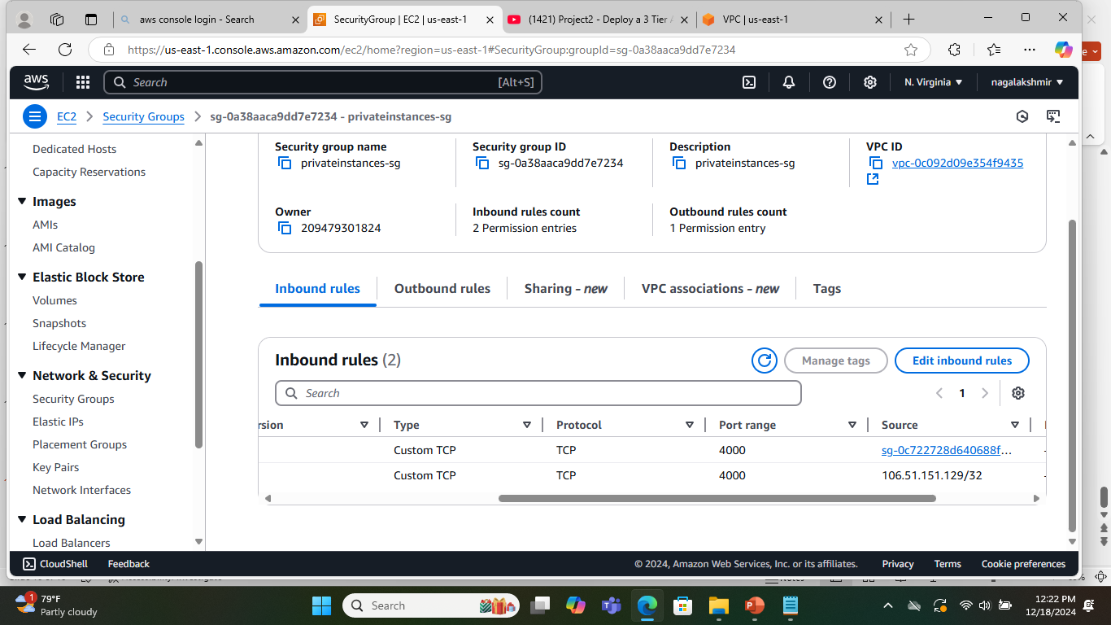
Private Instances Security Group
This Security Group opens up port 4000 for internal load balancer and My IP Address.

Slide 20
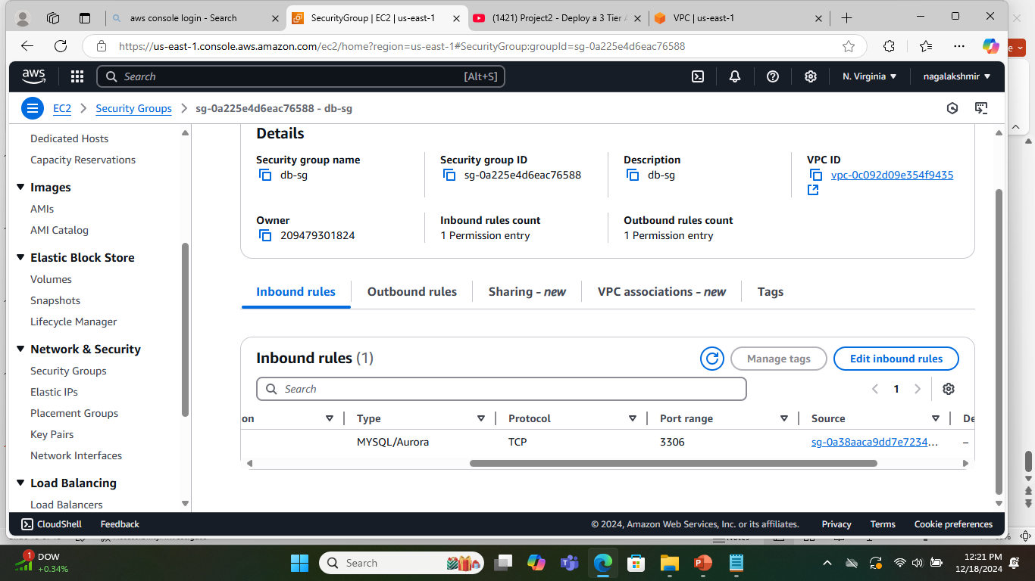
DB Security Group
This Security Group opens up port 3306 for private instances.

Slide 21
Part 2 : Database deployment
Subnet Groups
Database deployment
In this section we will be creating subnet groups for Database access and use RDS service for database deployment.

Slide 22
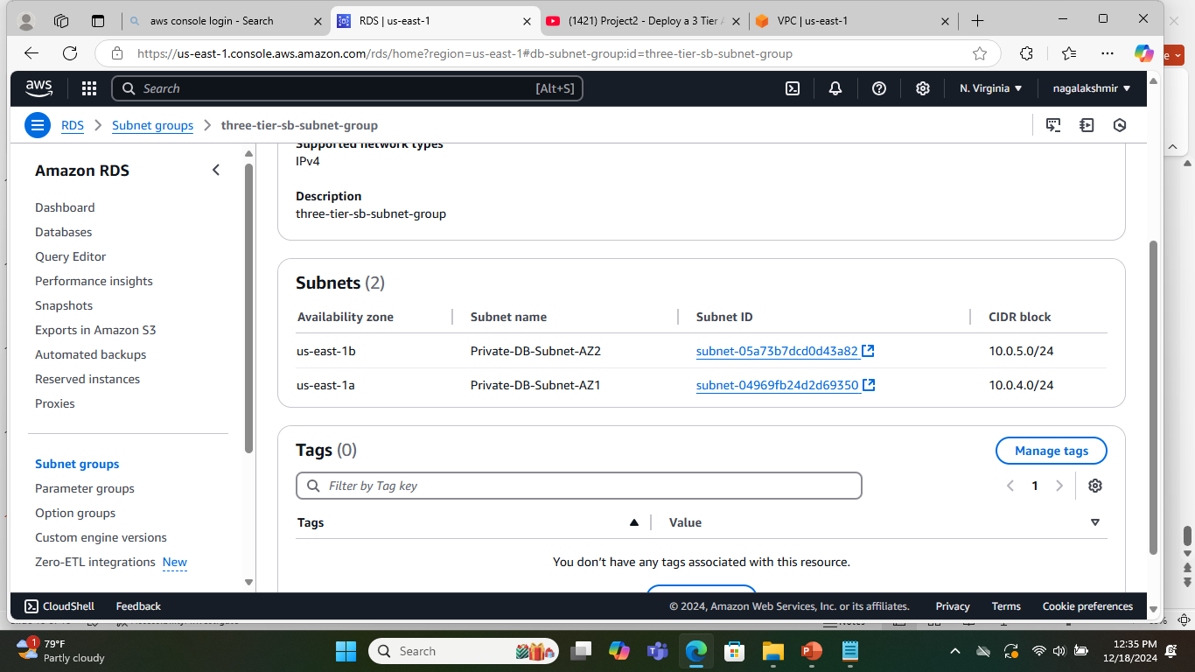
DB Subnet Groups
To provision RDS instances and AWS, we need DB Subnet Groups. This subnet group is for Availability Zones us-east-1a and us-east-1b. This group has private DB subnet in both the Availability Zones(10.0.4.0/24 & 10.0.5.0/24).

Slide 23
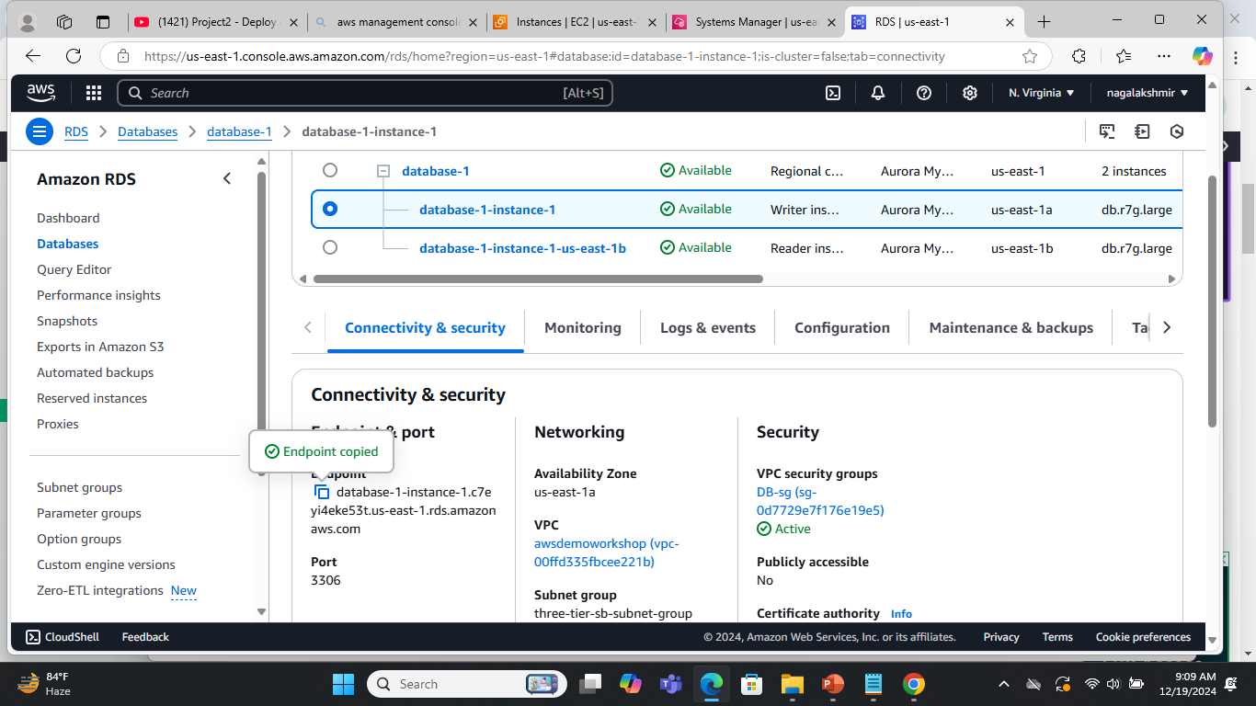
Database Deployment
This is database with Aurora Engine for DEV/Test environments. DB Security group firewall is applied. Username and Password is provided to login to database.

Slide 24
Part 3 : App Tier Instance deployment
MySQL client installation
PM2 installation
In this section we will be installing MySQL client and PM2 on EC2 instance.

Slide 25
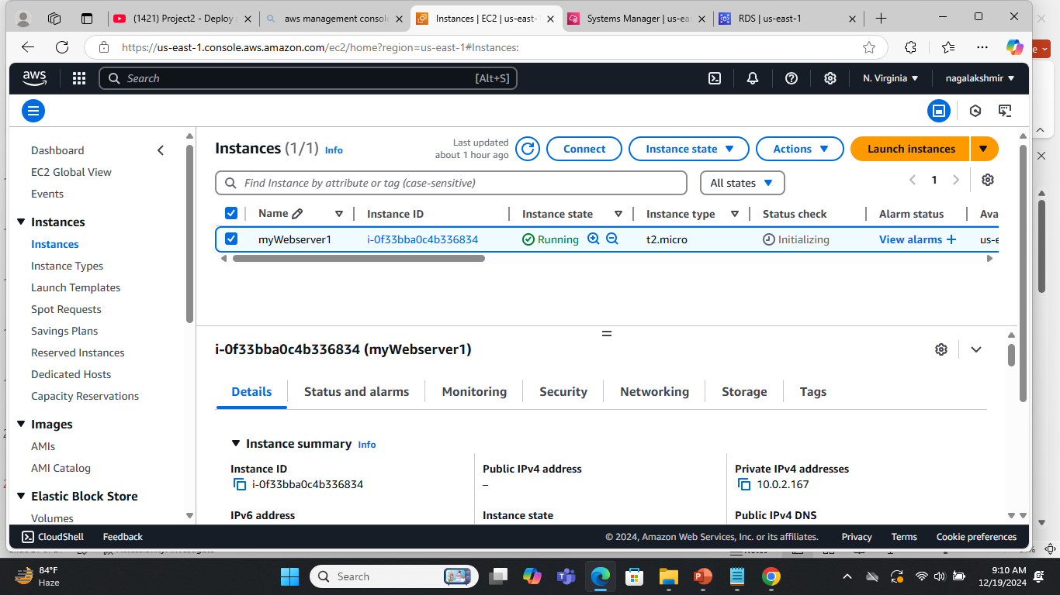
Appserver with MySQL Client
This is an EC2 instance with Linux Image, t2-micro instance type, private subnet in us-east-1a and private instance security group in a VPC that we created earlier. Demo-ec2role is applied.

Slide 26
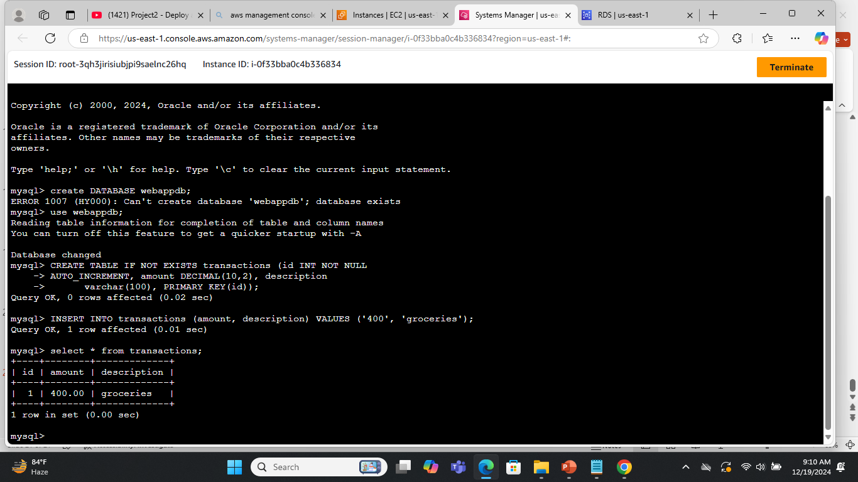
MySQL client installation and table creation
It’s a simple SQL shell with input line editing capabilities to interact with MySQL databases.

Slide 27
MySQL client installation and table creation
Commands Used:
wget https://dev.mysql.com/get/mysql84-community-release-el9-1.noarch.rpm
sudo rpm --import https://repo.mysql.com/RPM-GPG-KEY-mysql-2023
sudo yum install mysql84-community-release-el9-1.noarch.rpm
sudo yum install mysql
mysql -h database-1-instance-1.c7eyi4eke53t.us-east-1.rds.amazonaws.com -u admin -p
create DATABASE webappdb;
use webappdb;
CREATE TABLE IF NOT EXISTS transactions (id INT NOT NULL
AUTO_INCREMENT, amount DECIMAL(10,2), description varchar(100), PRIMARY KEY(id));
show tables;
INSERT INTO transactions (amount, description) VALUES ('400', 'groceries');
select * from transactions;

Slide 28
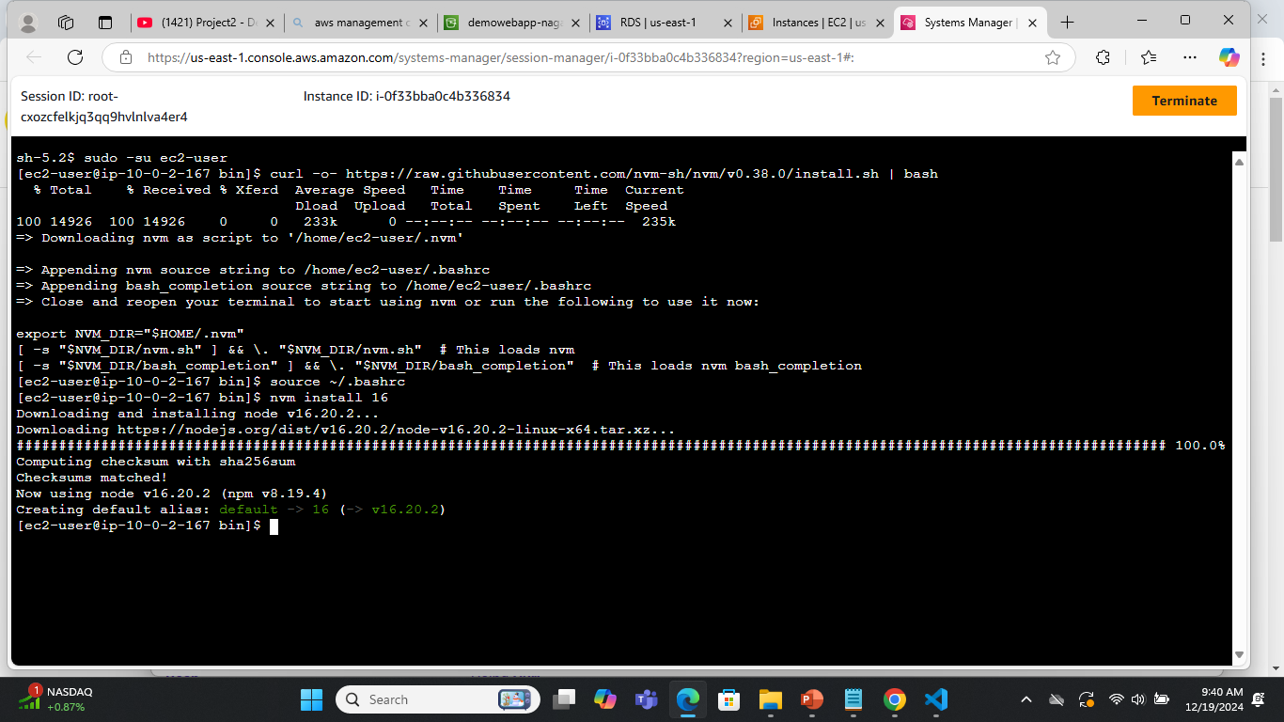
NVM installation in the Appserver
NVM allows you to quickly install and use different versions of node via the command line.

Slide 29
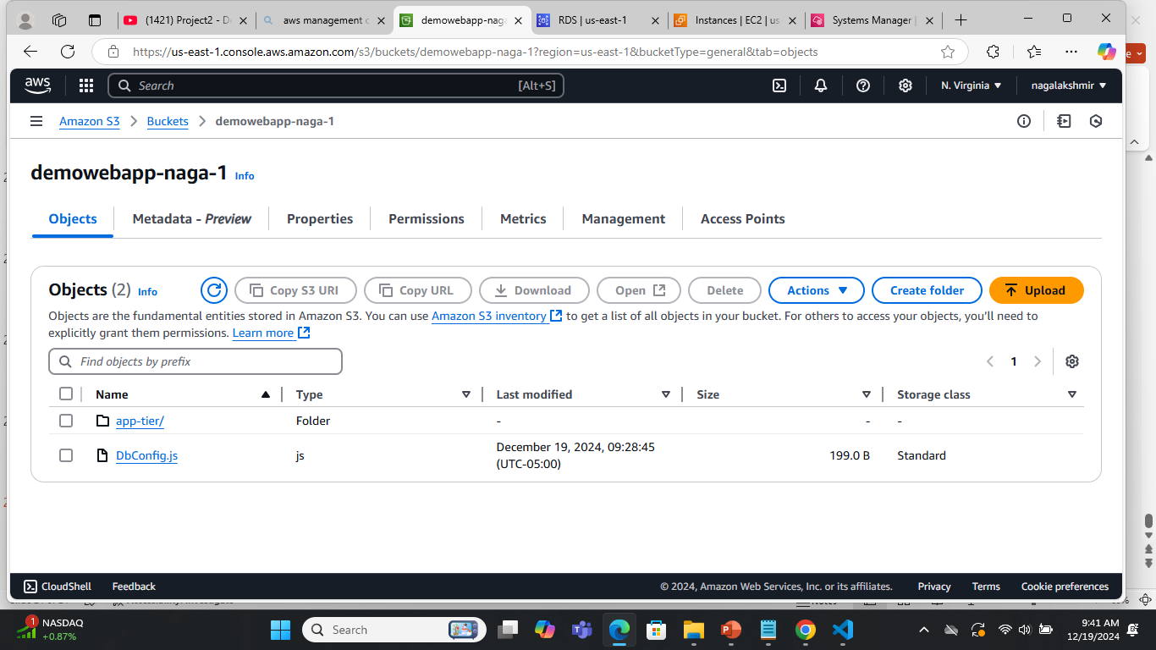
Upload Aplication code in S3 bucket

Slide 30
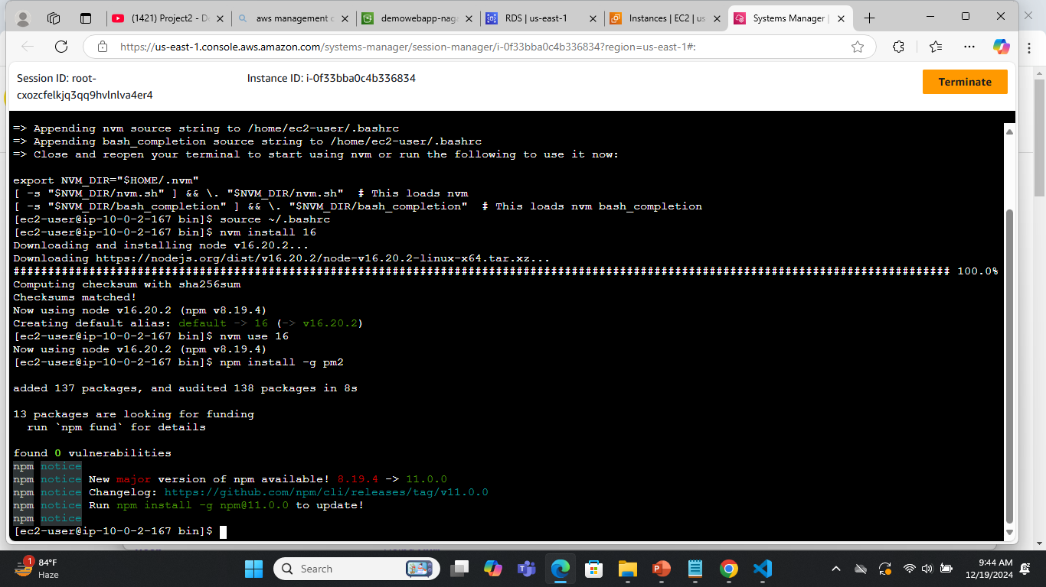
PM2 installation
This application uses PM2 daemon process manager to keep application online.

Slide 31
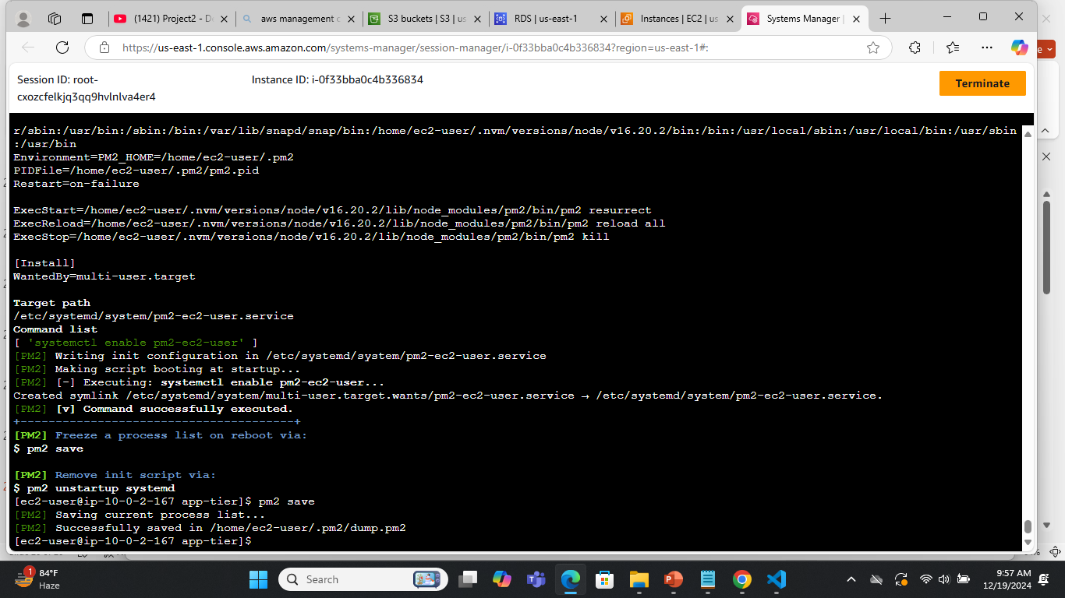
PM2 installation

Slide 32
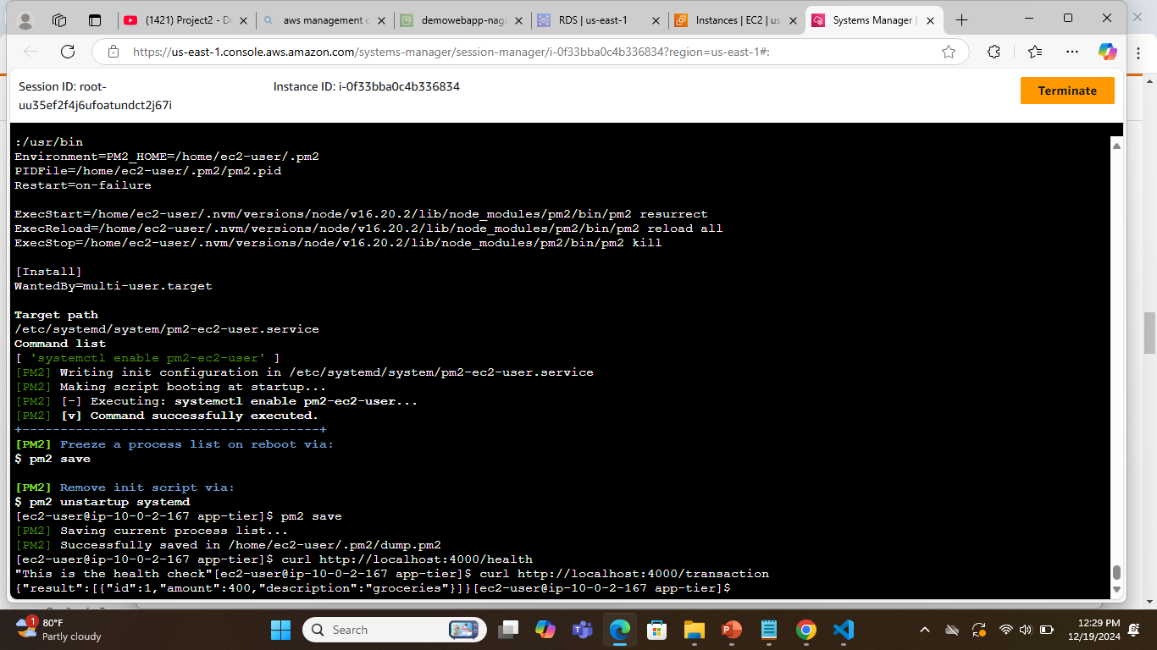
Invoking application to display content of transactions table
Copy application code from S3 bucket to webserver and start PM2.

Slide 33
PM2 installation Steps
curl -o- https://raw.githubusercontent.com/nvm-sh/nvm/v0.38.0/install.sh | bash
source ~/.bashrc
nvm install 16
nvm use 16
npm install -g pm2
npm install mysql --save
cd
aws s3 cp s3://demowebapp-naga-1/app-tier/ app-tier --recursive
cd app-tier
pm2 start index.js
pm2 logs
pm2 startup
curl http://localhost:4000/health
curl http://localhost:4000/transaction

Slide 34

Part 4 : Internal Load balancing and Autoscaling
AppTier AMI
TargetGroup
Internal Load Balancer
Launch template
Auto Scaling
In this section we will create an Amazon Machine Image of the App Tier instance and use that to setup autoscaling with a load balancer in order to make this tier highly available. Load balancer is a service that distributes incoming application traffic across multiple targets such as EC2 instances in various Availability Zones.
Auto scaling Group will scale the application automatically when the incoming traffic is high.

Slide 35
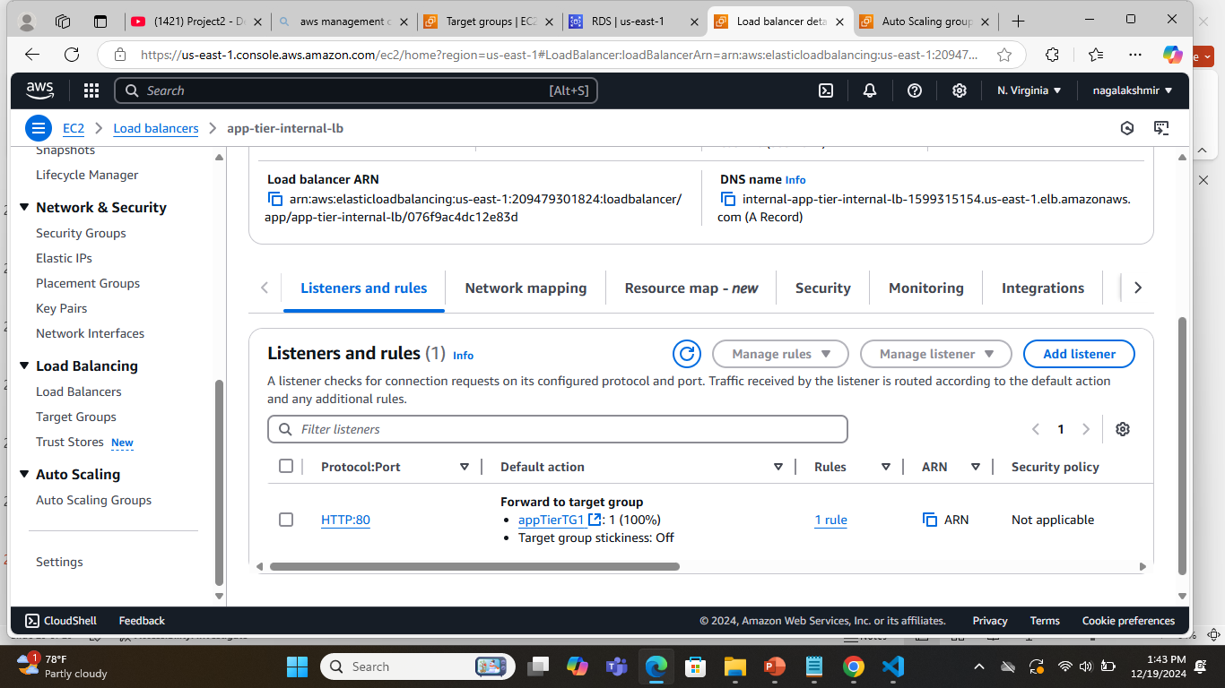
Internal Load Balancer
Create Image from App Tier instance. Create a internal Load balancer with the VPC created earlier, private subnet in us-east-1a and us-east-1b, internal-lb-security group. Open up the port 80 to redirect the traffic to the target group.
Target Group is with VPC that we created earlier , HTTP on port 4000 and /health folder for health check.

Slide 36
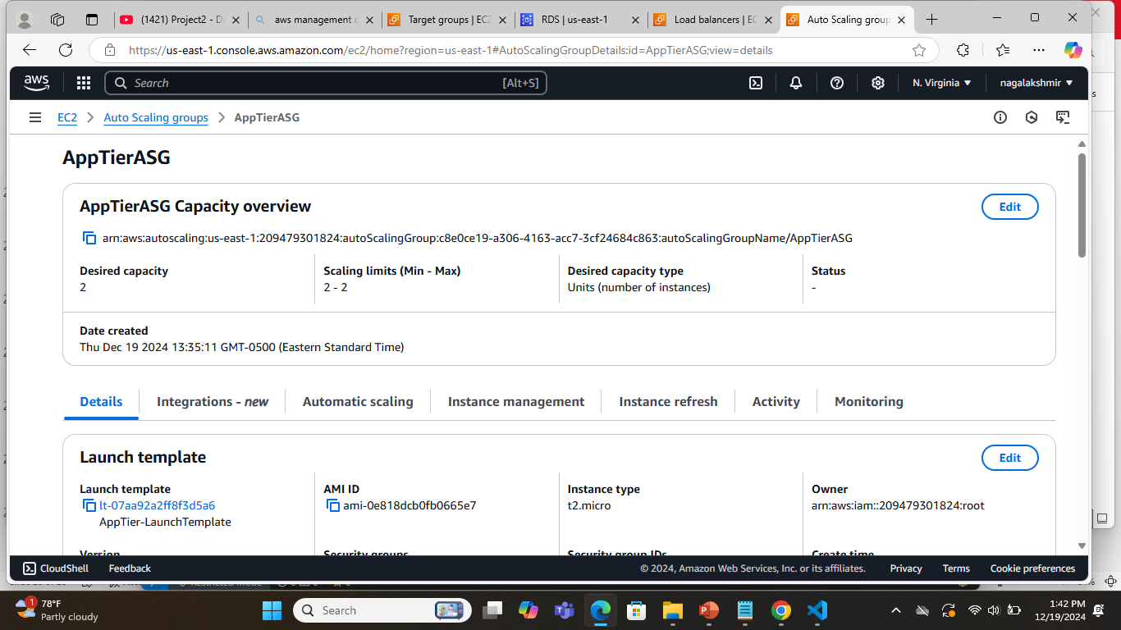
Autoscaling Group
Create a Launch Template with App Tier Image , t2.micro instance type, Private intances security Group and demo-ec2role.
Create a AutoScaling group with AppTier Launch template with desired capacity of 2, Maximum of 2 instances.

Slide 37

Part 5 : Web Tier Application Deployment
Nginx Configuration
In this section we will create a web server and install nginx.
nginx is an HTTP web server, reverse proxy, content cache, load balancer, TCP/UDP proxy server, and mail proxy server.

Slide 38
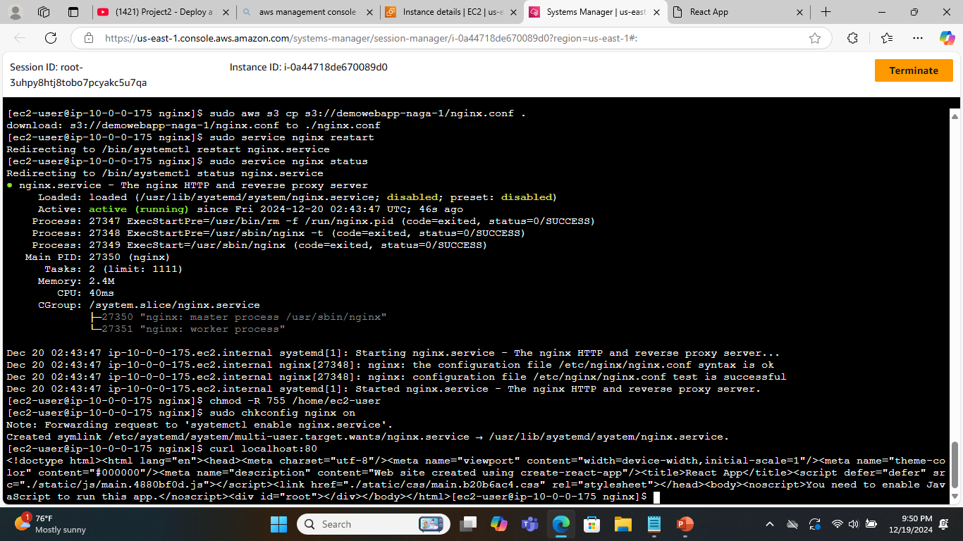
nginx installation
Create an instance with public IP Address, Public web subnet in us-east-1a, VPC that we created earlier, Web Tier security Group and demo-ec2role. Connect to the instance and install nginx.

Slide 39
nginx installation steps
curl -o- https://raw.githubusercontent.com/nvm-sh/nvm/v0.38.0/install.sh | bash
source ~/.bashrc
nvm install 16
nvm use 16
aws s3 cp s3://demowebapp-naga-1/web-tier/ web-tier --recursive
ls
cd web-tier
npm install
npm run build
sudo yum install nginx
cd /etc/nginx
sudo cp nginx.conf nginx.conf_bkp
sudo aws s3 cp s3://demowebapp-naga-1/nginx.conf .
sudo service nginx restart
sudo service nginx status
chmod -R 755 /home/ec2-user
sudo chkconfig nginx on

Slide 40
Part 6 : Web Tier Load balancing and Autoscaling
AMI
Load Balancer
Launch template
Autoscaling Group
In this section we will create an Amazon Machine Image of the Web Tier instance and use that to setup autoscaling with a load balancer in order to make this tier highly available. Load balancer is a service that distributes incoming application traffic across multiple targets such as EC2 instances in various Availability Zones.
Auto scaling Group will scale the application automatically when the incoming traffic is high.

Slide 41
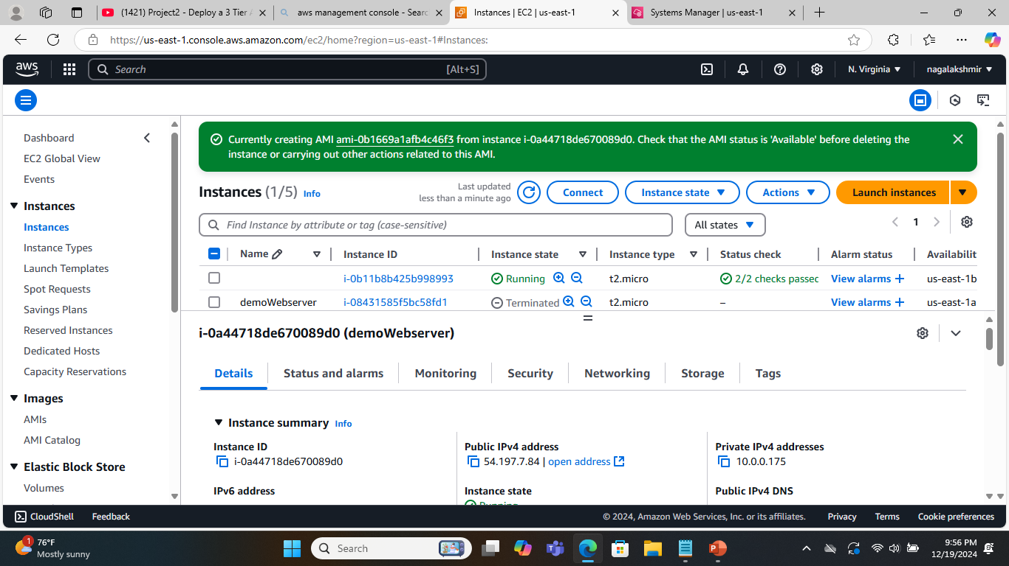
Amazon Machine Image
This is the machine Image of the Web Tier Instance.

Slide 42
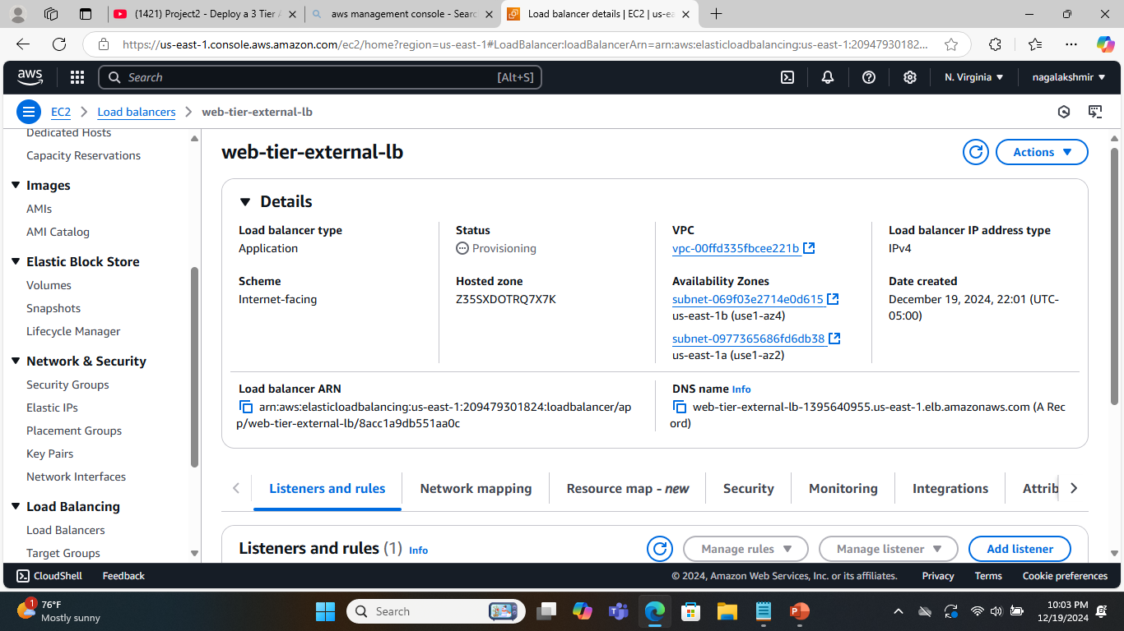
External Load Balancer
Create an external Load balancer with the VPC created earlier, public subnet in us-east-1a and us-east-1b, internetrfacing-lb-security group. Open up the port 80 to redirect the traffic to the target group.
Target Group is with VPC that we created earlier , HTTP on port 80 and /health folder for health check.

Slide 43
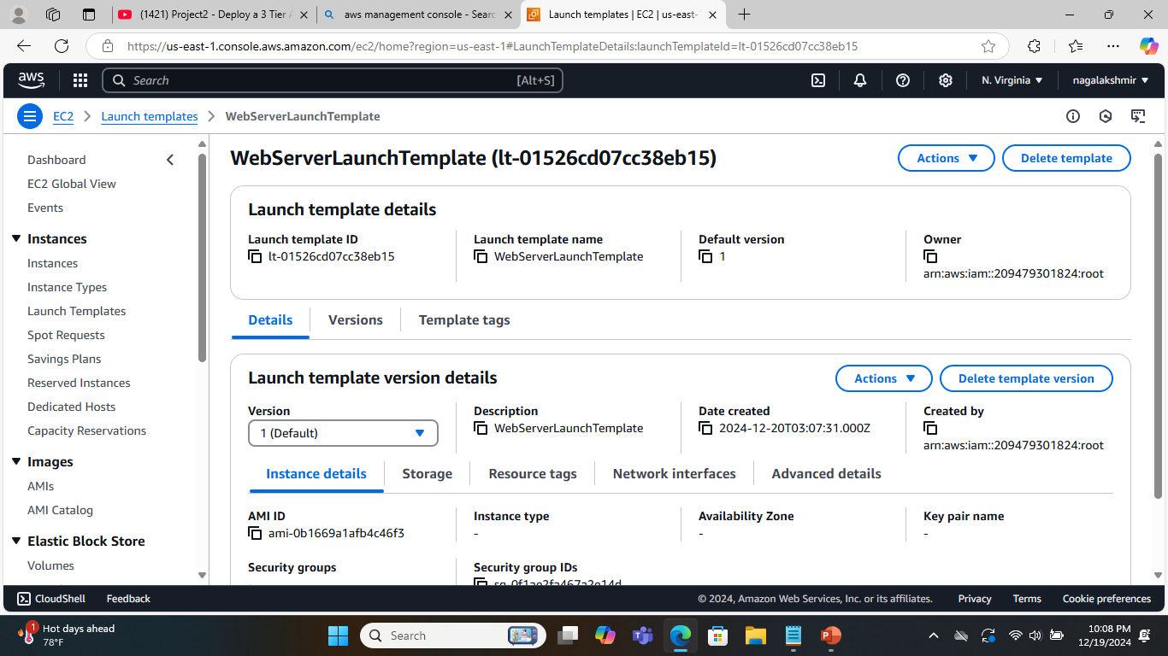
Launch Template
Create a Launch Template with App Tier Image , t2.micro instance type, Private intances security Group and demo-ec2role.

Slide 44
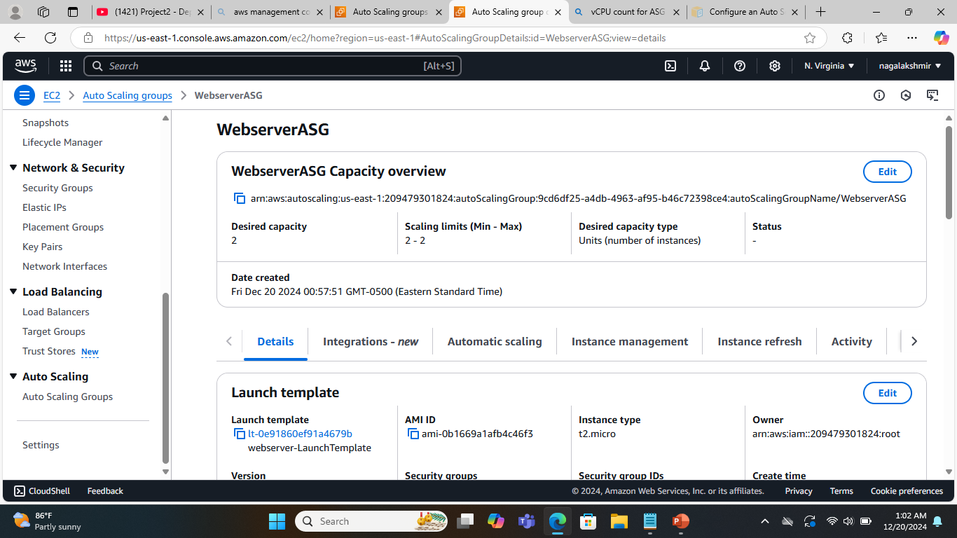
AutoScaling Group
Create a AutoScaling group with WebTier Launch template with desired capacity of 2, Maximum of 2 instances.

Slide 45
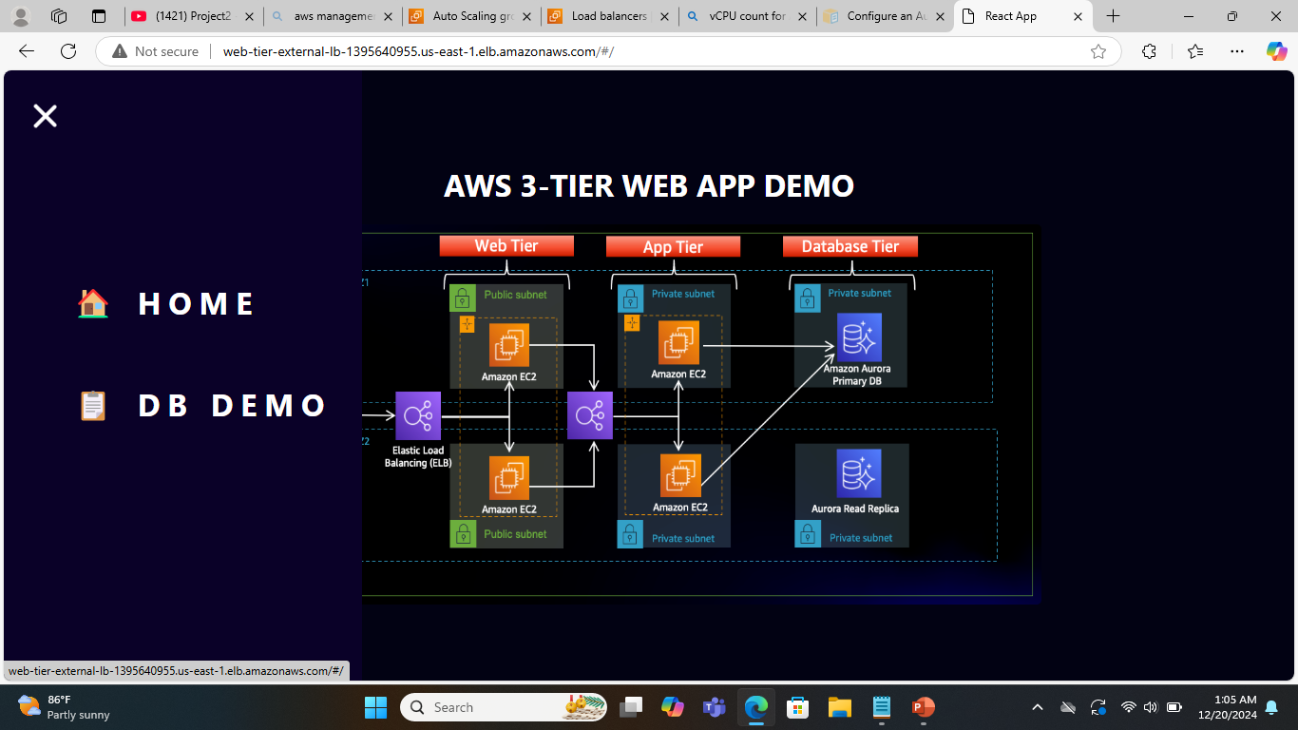
AWS 3-TIER WEB APP DEMO Home Page

Slide 46
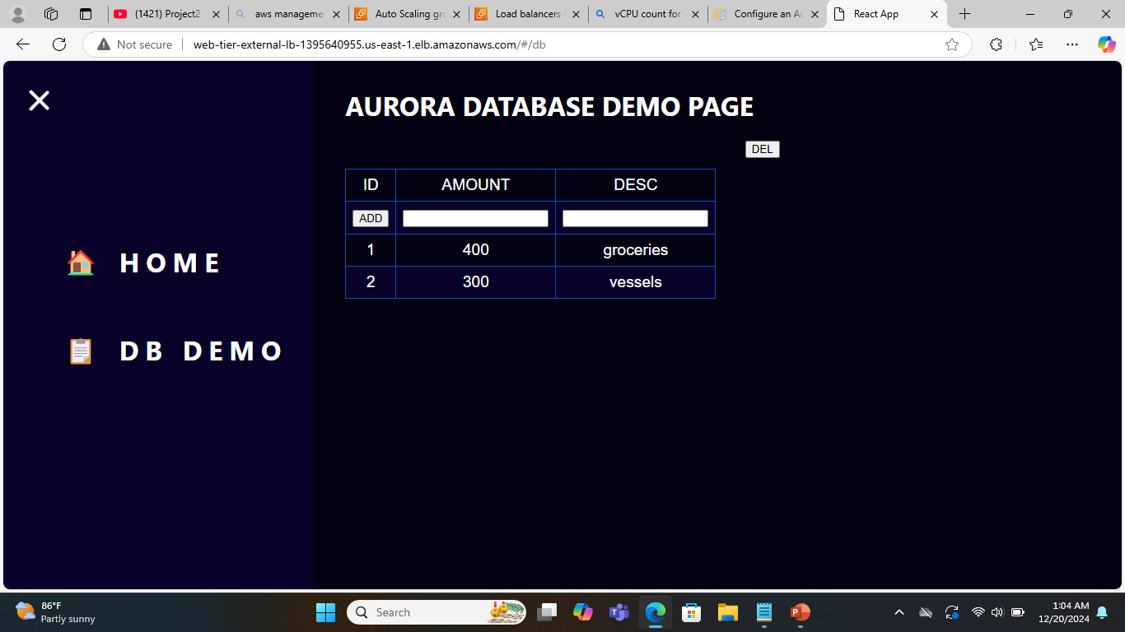
Database Demo Page

Slide 47
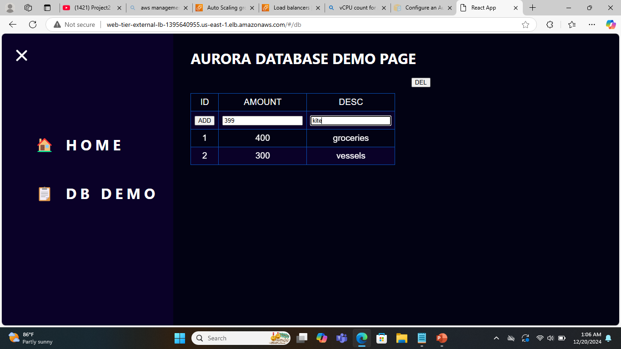
Adding record to the database

Slide 48

Record added to the database

Slide 49

Delete the records in the database

